Slide 1
DataBase Management System Lab (4CS4-22) Experiment No. -3 Topic to be covered : Execute DML Statements in SQL Like Insert,Select,Delete and Update

Slide 2
The SQL INSERT INTO Statement
The INSERT INTO statement is used to insert new records in a table.
INSERT INTO Syntax
It is possible to write the INSERT INTO statement in two ways:
Specify both the column names and the values to be inserted:
Syntax
INSERT INTO table_name (column1, column2, column3, ...) VALUES (value1, value2, value3, ...);
2. If you are adding values for all the columns of the table, you do not need to specify the column names in the SQL query. However, make sure the order of the values is in the same order as the columns in the table.
Syntax
INSERT INTO table_name VALUES (value1, value2, value3, ...);

Slide 3
Example:
INSERT INTO Customers (CustomerName, ContactName, Address, City, PostalCode, Country) VALUES ('Cardinal', 'Tom B. Erichsen', 'Skagen 21', 'Stavanger', '4006', 'Norway');
INSERT INTO Customers (CustomerName, City, Country) VALUES ('Cardinal', 'Stavanger', 'Norway');
INSERT Multiple Rows
INSERT INTO table_name (column_list)
VALUES (value_list_1), (value_list_2), ... (value_list_n);

Slide 4
INSERT INTO SELECT statement
To insert data from other tables into a table, you use the following SQL Server INSERT INTO SELECT statement:
Syntax:
INSERT INTO target_table (column_list) Query
Example:
INSERT INTO sales.addresses (street, city, state, zip_code) SELECT street, city, state, zip_code FROM sales.customers

Slide 5
The SQL UPDATE Statement
The UPDATE statement is used to modify the existing records in a table.
UPDATE Syntax:
UPDATE table_name SET column1 = value1, column2 = value2, ... WHERE condition;
Note: The WHERE clause specifies which record(s) that should be updated. If you omit the WHERE clause, all records in the table will be updated
Example:
UPDATE Customers SET ContactName = 'Alfred Schmidt', City= 'Frankfurt' WHERE CustomerID = 1;

Slide 6
UPDATE Multiple Records
It is the WHERE clause that determines how many records will be updated.
The following SQL statement will update the ContactName to "Juan" for all records where country is "Mexico":
Example
UPDATE Customers SET ContactName='Juan' WHERE Country='Mexico';

Slide 7
The SQL DELETE Statement
The DELETE statement is used to delete existing records in a table.
DELETE Syntax
DELETE FROM table_name WHERE condition;
Note: The WHERE clause specifies which record(s) should be deleted. If you omit the WHERE clause, all records in the table will be deleted
SQL DELETE Example
The following SQL statement deletes the customer "Alfreds Futterkiste" from the "Customers" table
Example
DELETE FROM Customers WHERE CustomerName='Alfreds Futterkiste';

Slide 8
Delete All Records
It is possible to delete all rows in a table without deleting the table. This means that the table structure, attributes, and indexes will be intact
Syntax:
DELETE FROM table_name;
The following SQL statement deletes all rows in the "Customers" table, without deleting the table:
Example
DELETE FROM Customers;

Slide 9
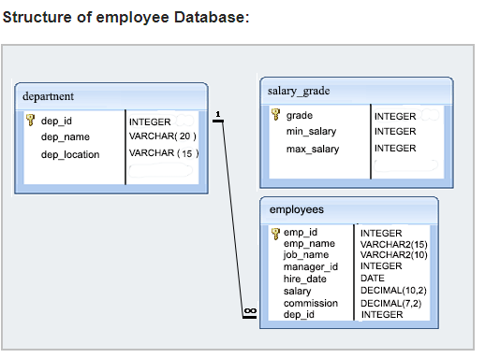
Example: Create table with the following constraints:
Table name : Department, Salarygrade, Employees

Slide 10
https://www.w3resource.com/sql-exercises/employee-database-exercise/index.php

